Slide 1
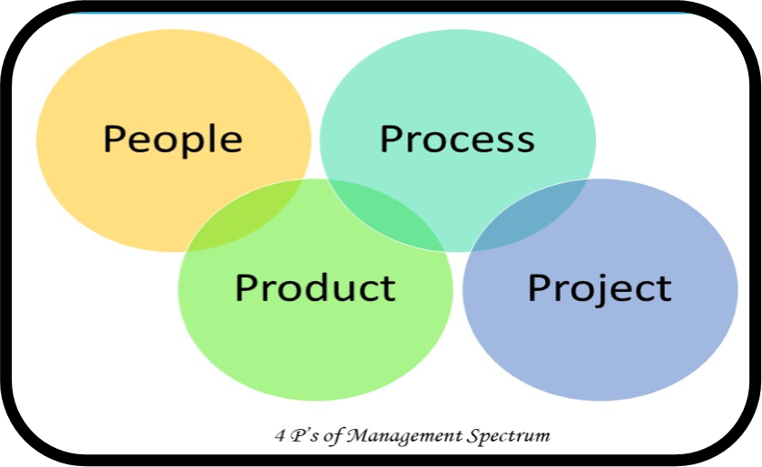
Management Spectrum: 4P’s of Project Management

Slide 2

PEOPLE
Senior Managers
Practitioners
End-Users
Project Managers
Customers

Slide 3
Leadership vs Management

Slide 4


Leadership
“One who has follower” Peter Drucker
“Leadership is the name of influence” Jhon C. Maxwell
“If your actions inspire others to dream more, learn more, do more, and become more, you are a leader” Jhon Quincy Adams
Continued…

Slide 5
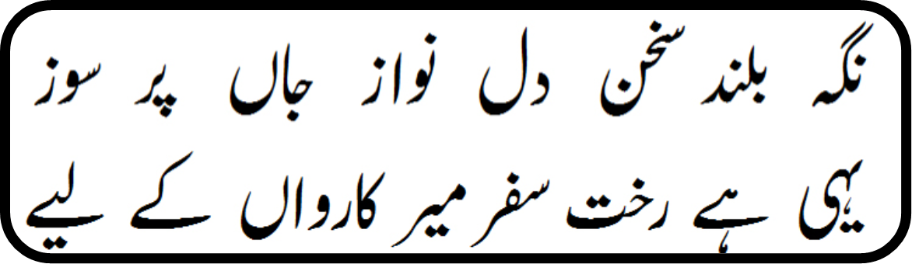
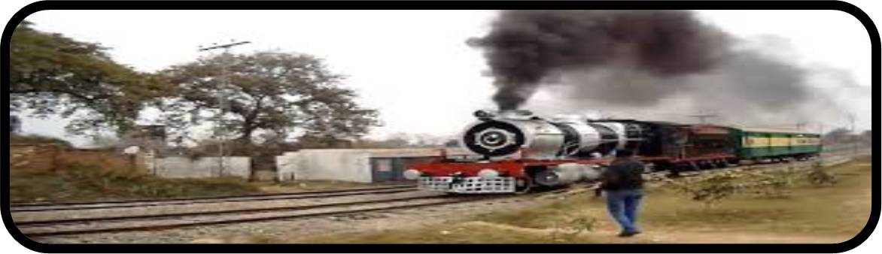
Leadership
By Allama Muhammad Iqbal
By Baoo Gi

Slide 6


Characteristics of Leadership
State of mind
Character
Vision
Bonding force for people (Team Management)
Make people work (Motivation)
DNA of Leader
Driving force
Desire to lead
Desire to take responsibility
Integrity
Self confidence
Intelligence
Job relevant knowledge

Slide 7
Leadership
Jerry Weinberg's MOI Model
Motivation (Push or Pull)
Organization
Innovation or Ideas
Effective Characteristics of Project Manager
Problem Solving
Managerial Identity
Achievement
Influence

Slide 8
Team vs Group

Slide 9
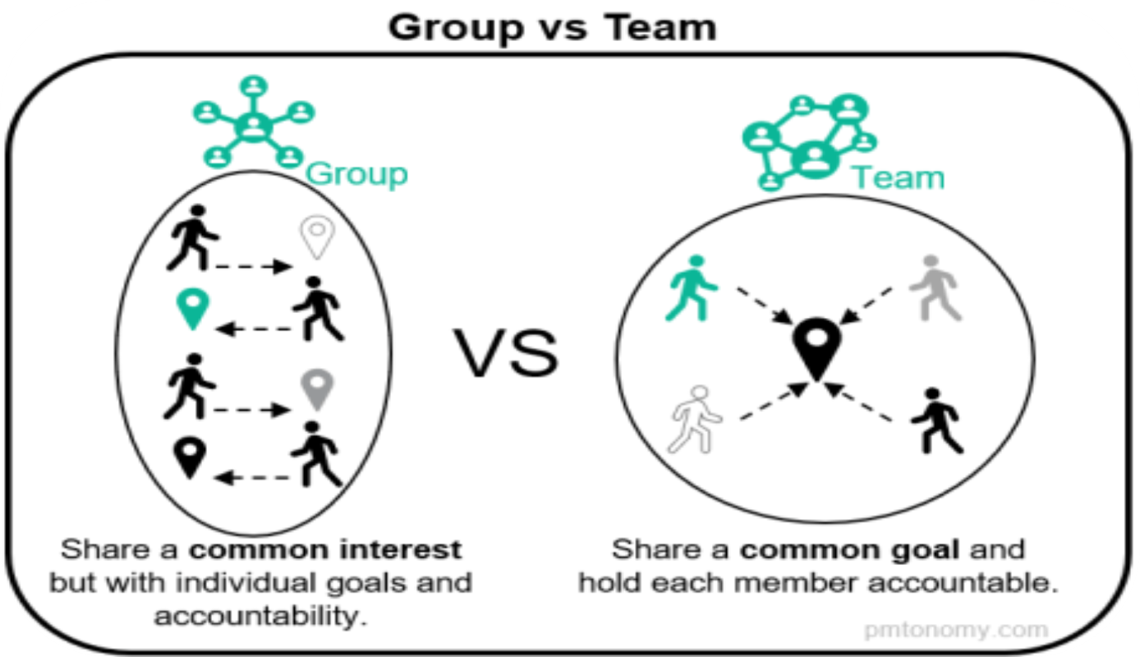
Team Vs Group

Slide 10
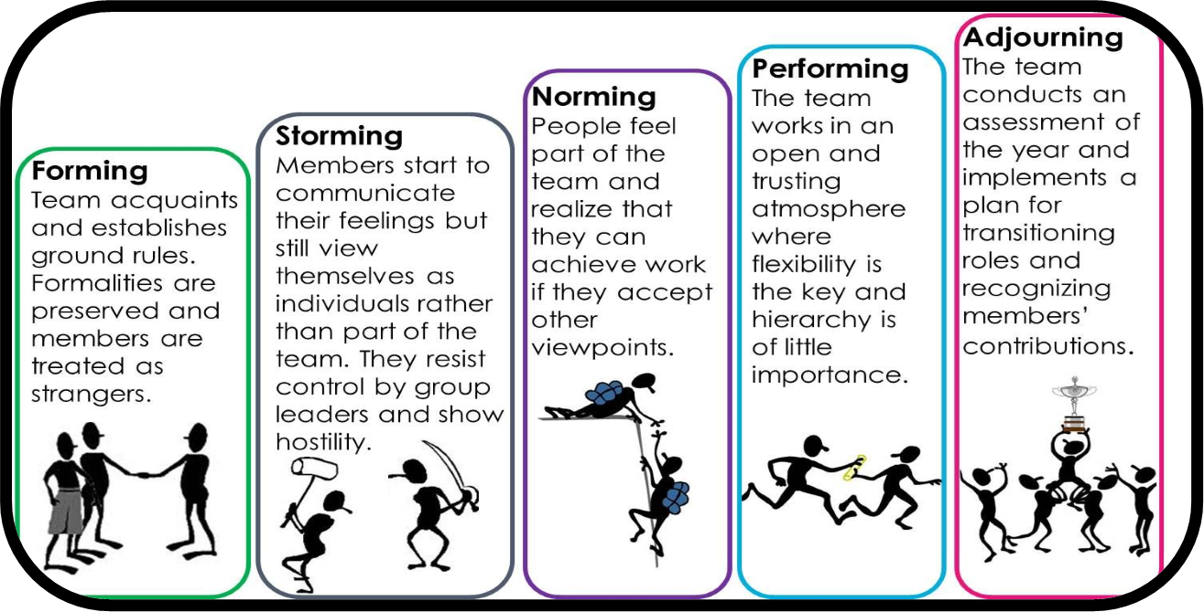
Team:
Tuckman’s Team Model, 1965

Slide 11
Team Structures:
Control Centralized (CC) (Chief Programmer)
Communication: Vertical > Horizontal
Decision Making: Order and obey (Dictatorship)
Leadership: Permanent
Democratic Decentralized (DD) (Innovative Anarchy)
Communication: Horizontal > Vertical
Decision Making: With consensus
Leadership: Rotation based
Controlled Decentralized (CD) (Agile Team)
Communication: Vertical > Horizontal
Decision Making: as per situation
Leadership: Mix

Slide 12
The Product
The term product includes any software that’s is to be built at the request of others
The Product objectives and scope should be established before planning a project
The Second step is to consider the alternate solutions
The “best” solution is then selected, keeping in mind the deadlines, budget, resources, people and other constraints

Slide 13
The Product
Software Scope
  Context
  Information Objectives (Input, output)
  Function and Performance
Problem Decomposition
  Work Breakdown Structure (WBS)

Slide 14
The Process
Selection of Model
Combining Product and Process
Process Decomposition

Slide 15
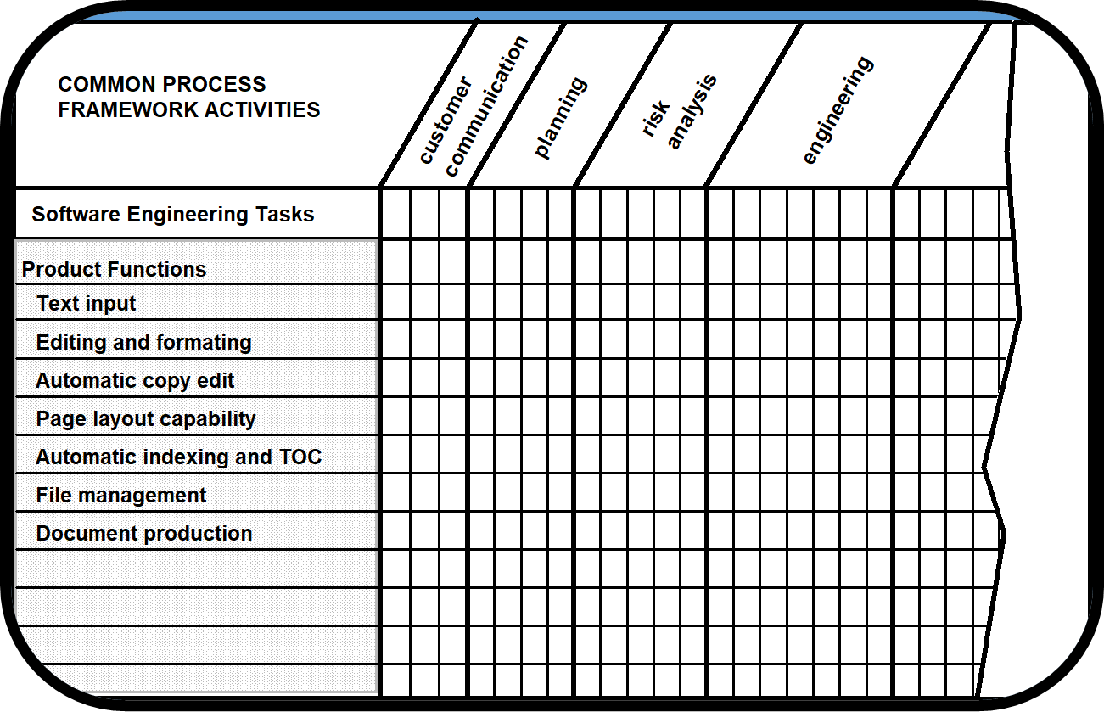
Melding the Product and the Process

Slide 16
The Project : Reasons of Jeopardy
Lack of customer’s need understanding
Product scope poorly defined
Changes managed poorly
Change in technology
Business needs change
Unrealistic deadlines
Resistant Users
Lost sponsorship
Lack of appropriate skills
Lessons not learnt

Slide 17
The Project : Jeopardy Avoidance
Start on right foot
Maintain momentum
Track progress
Make smart decisions
Conduct postmortem analysis

Slide 18
Conclusion
Software Project Management is an umbrella activity within software engineering
It begins before any technical activity is initiated and continues throughout the definition, development, and support of computer software
Four P’s have substantial influence on software project management
The PM activity encompasses measurements and metrics, estimation, risk analysis, schedules, tracking and control. Each of these topics is considered in the chapters that follow

Slide 19
References:
Software Engineering - A practitioner’ s Approach by Roger S. Pressman
  Chapter 21
    21.1 – (21.1.1, 21.1.2, 21.1.3, 21.1.4)
    21.2 – (21.2.1, 21.2.2, 21.2.3)
    21.3 – (21.3.1, 21.3.2)
    21.4
    21.5
    Handouts

